Slide 1
Automated On-Sun Analysis
Including module modeling and flux map characterization

Slide 2
Module Inputs
Calibration Constants/Experimental Configuration
Flux Map
Module ART (spatial)
Module Design
Optical Stack ART
Design characteristics
Modeled/Measured Properties
Experimental Results

Slide 3
Calibration Constants:
Directly In Code
masking = 0.35
shading = 0.08 #on dish from receiver
mirror_loss = 0.11
#Calibration constants
PV_flow_cal = (20/3-2/6)/(5)
TR_flow_cal = 200/(5*60)
PV_pres_cal = 15/0.12
GHI_cal = 5000
DNI_cal = 0.00000776
Cp_water = 4.184
TR fraction = 0.57 #open area after CPV before receiver, estimated
TR efficiency = 0.95
CPV_mismatch = 0.085
Module Series Resistance = 0.126 Ohms
Cell_area = 0.0055**2

Slide 4
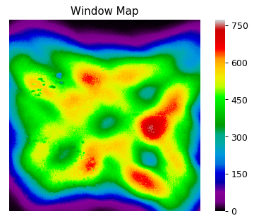
Flux Map:
Modeling/Flux_Maps
58.5_844 DNI
Run with: OpticalFluxChar.py
Inputs
Flux maps
58.5_844DNI.xlsx (Mod 5, 6 position)
65.0_515DNI.csv (Mod 7+ position)
Aperture Size
Module ART (optional)
Outputs:
Flux maps (visual)
Concentration maps (text)
Module Spatial ART
Module 6 Spatial ART
 | Cell | Bypass | Bypass w/Ch
Absorption | 0.6345 | 0.0491 | 0.0666
Reflection | 0.2445 | 0.0662 | 0.0808
Transmission | 0.121 | 0.8847 | 0.8526
Mod6_58.5 Spatial ART
 | Bypass No Chan | Bypass Chan | Cells | Total
Power | 0.4329 | 0.2078 | 0.3592 | 1
A | 0.0212 | 0.0138 | 0.2279 | 0.2630
R | 0.0286 | 0.0167 | 0.0878 | 0.1332
T | 0.3829 | 0.1772 | 0.0434 | 0.6036

Slide 5
Module Design
Modeling/Module_Properties
Run with: CPVPerformance.py
Input
Cell ART
Cell Eff (hardcoded at 22% from John’s calc.)
Module Design (encap thickness, cells, etc.)
Outputs
Temp Maps
Heat fraction
Elec. Fraction
Thermal Restiance

Slide 6
Experimental Results
Test_Data
Data Logger Header
Data Logger – Temperatures, Pressures, DNI
IV sweep data
IV sweep stats
MPP data
Following data shows the analysis of Mod6 Tests done on 1-23-18 using the 58.5_844DNI flux map

Slide 7
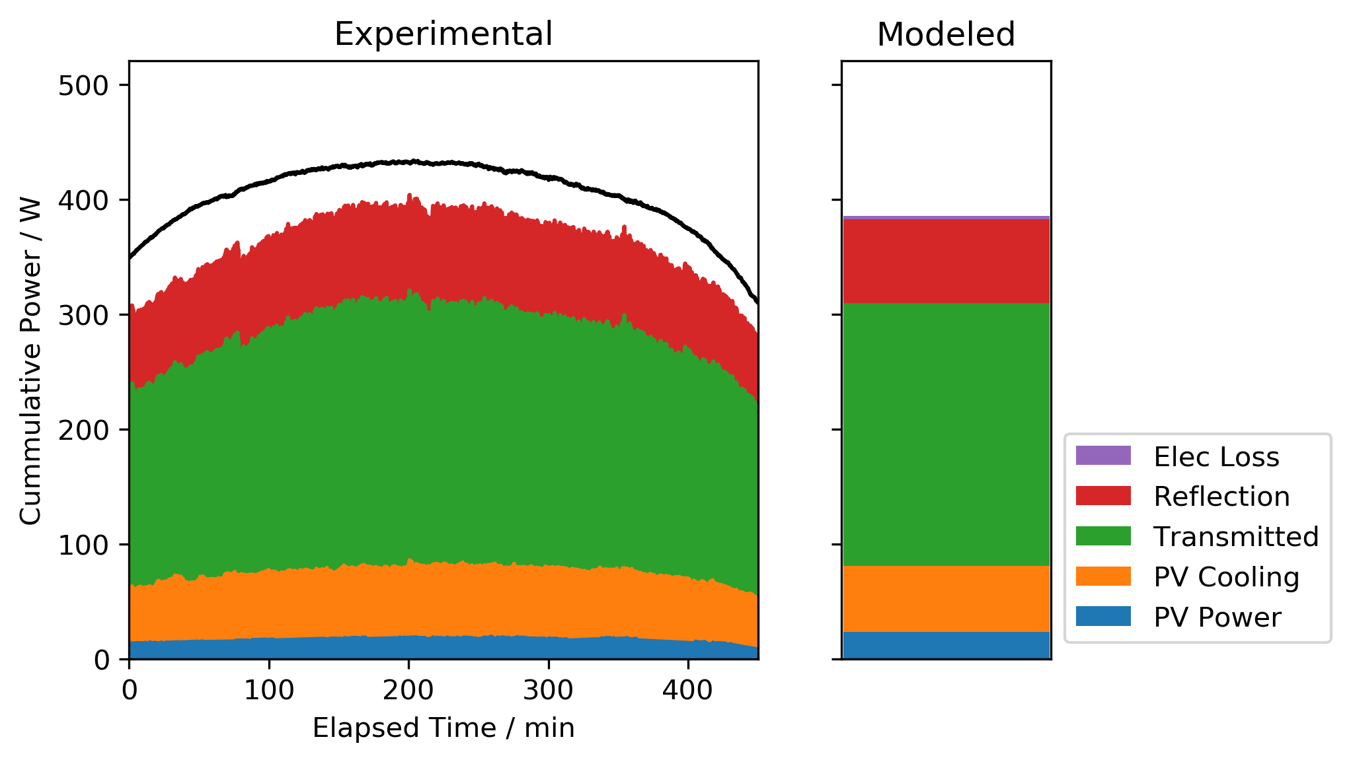
Outputs: Power flow analysis
 | Exp | Model | %delta
PV Cooling | 55.61 | 57.24 | -2%
PV Power | 15.63 | 23.94 | -34%
Reflection | 76.8 | 72.98 | 5%
Transmitted | 202 | 228 | -11%

Slide 8
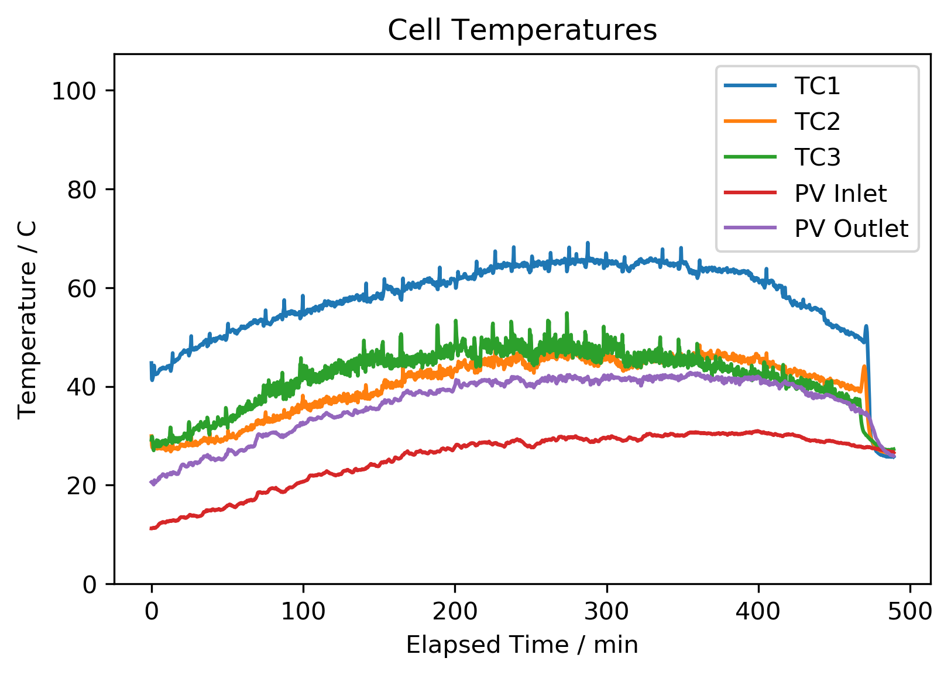
Cell Temperature
Predicted Temperatures
Loc. Conc. Temp (degC)
PV TC1 AB22 492 71.61
PV TC2 BC66 445 70.54
PV TC3 FG55 531 76.695
Avg None 459 71.6188

Slide 9
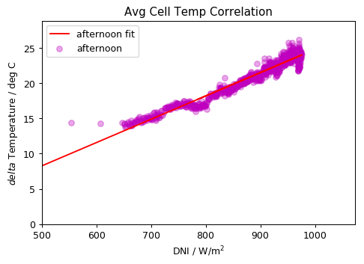
Thermal Resistance Calculation
Plots available for all other TCs as well
 | Conc. | Morn | Std err | Afternoon | Std err
Avg | 459 | 2.2 | 0.07 | 5.6 | 0.04
PV TC1 | 492 | 1.6 | 0.11 | 7.09 | 0.063
PV TC2 | 445 | 0.45 | 0.08 | 2.92 | 0.045
PV TC5 | 531 | 3.8 | 0.14 | 5.6 | 0.91

Slide 10
Updates
Easy
Comparison of Thermal Resistance
Comparison of Temperatures
Jsc vs DNI plots
Slightly Harder
Electrical characterization

Slide 11
Data to Check
Cell ART - Vera
Mod ART - Vera

Slide 12
Mod 6 Cell ART
 | Air-N-BK7 | N-BK7-Silicone | Silicone-Solar cell | Solar cell-Silicone | Silicone-Sapphire | Sapphire-Water | Water-N-BK7 | N-BK7-Air
In-band T | 0.9651 | 0.9648 | 0.8733 | 0 | 0 | 0 | 0 | 0
Out-of-band T | 0.9665 | 0.9662 | 0.8255 | 0.6772 | 0.6764 | 0.6658 | 0.6397 | 0.6228
Total T | 0.9656 | 0.9653 | 0.8574 | 0.2264 | 0.2261 | 0.2226 | 0.2138 | 0.2082
In-band R | 0.0349 | 0.0352 | 0.1241 | 0.1241 | 0.1241 | 0.1241 | 0.1241 | 0.1241
Out-of-band R | 0.0335 | 0.0338 | 0.1697 | 0.2 | 0.2007 | 0.2103 | 0.2112 | 0.2262
Total R | 0.0344 | 0.0347 | 0.1393 | 0.1495 | 0.1497 | 0.1529 | 0.1532 | 0.1582
In-band A | 0 | 0 | 0.0026 | 0.8759 | 0.8759 | 0.8759 | 0.8759 | 0.8759
Out-of-band A | 0 | 0 | 0.0048 | 0.1228 | 0.1229 | 0.1238 | 0.149 | 0.1509
Total A | 0 | 0 | 0.0033 | 0.6242 | 0.6242 | 0.6245 | 0.6329 | 0.6336
Inband A | 0 | 0 | 0.0026 | 0.8733 | 0 | 0 | 0 | 0
outofband A | 0 | 0 | 0.0048 | 0.118 | 0.0001 | 0.001 | 0.0252 | 0.0019
total A | 0 | 0 | 0.0033 | 0.6209 | 0 | 0.0003 | 0.0084 | 0.0006

Slide 13
Cell region: no busbar no backside
 |  |  |  | transmission | reflection | absorption
No. | Layer | Material | Thickness | in-band | out-band | total energy | in-band | out-band | total energy | in-band | out-band | total energy
1 | Air |  |  |  |  |  |  |  |  | 0.00% | 0.00% | 0.00%
2 | Module superstrate | Fused Quartz | 3mm | 96.51% | 96.65% | 96.56% | 3.49% | 3.35% | 3.44% | 0.62% | 0.30% | 0.51%
3 | Upper encapsulant | Silicone | 50um | 95.87% | 96.33% | 96.02% | 0.02% | 0.02% | 0.02% | 0.07% | 0.24% | 0.13%
4 | Solar cell substrate | GaAs@4.5E16 cm-3 | 455um | 89.84% | 85.39% | 88.35% | 5.96% | 10.70% | 7.55% | 89.84% | 12.17% | 63.88%
5 | Lower encapsulant | Silicone | 50um | 0.00% | 69.98% | 23.39% | 0.00% | 3.24% | 1.08% | 0.00% | 0.21% | 0.07%
6 | Thermal conductor | Sapphire | 1mm | 0.00% | 69.71% | 23.30% | 0.00% | 0.06% | 0.02% | 0.00% | 0.11% | 0.04%
7 | Cooling fluid | Water | 145um | 0.00% | 68.58% | 22.92% | 0.00% | 1.02% | 0.34% | 0.00% | 3.58% | 1.19%
8 | Module substrate | N-BK7 | 3mm | 0.00% | 64.91% | 21.70% | 0.00% | 0.09% | 0.03% | 0.00% | 0.41% | 0.14%
9 | Air |  |  | 0.00% | 62.95% | 21.04% | 0.00% | 1.54% | 0.51%
 |  |  |  |  | Air-Fused Quartz | Fused Quartz-Silicone | Silicone-Solar cell | Solar cell-Silicone | Silicone-Sapphire | Sapphire-Water | Water-Fused Quartz | Fused Quartz-Air
 |  |  |  | In-band T | 96.51% | 95.87% | 89.84% | 0.00% | 0.00% | 0.00% | 0.00% | 0.00%
 |  |  |  | Out-of-band T | 96.65% | 96.33% | 85.39% | 69.98% | 69.71% | 68.58% | 64.91% | 62.95%
 |  |  |  | Total T | 96.56% | 96.02% | 88.35% | 23.39% | 23.30% | 22.92% | 21.70% | 21.04%
 |  |  |  | In-band R | 3.49% | 3.51% | 9.47% | 9.47% | 9.47% | 9.47% | 9.47% | 9.47%
 |  |  |  | Out-of-band R | 3.35% | 3.37% | 14.07% | 17.31% | 17.37% | 18.40% | 18.49% | 20.03%
 |  |  |  | Total R | 3.44% | 3.46% | 11.01% | 12.09% | 12.11% | 12.46% | 12.49% | 13.00%
 |  |  |  | In-band A | 0.00% | 0.62% | 0.69% | 90.53% | 90.53% | 90.53% | 90.53% | 90.53%
 |  |  |  | Out-of-band A | 0.00% | 0.30% | 0.54% | 12.71% | 12.92% | 13.03% | 16.60% | 17.01%
 |  |  |  | Total A | 0.00% | 0.51% | 0.64% | 64.52% | 64.59% | 64.62% | 65.82% | 65.96%

Slide 14
Cell region: with busbar no backside
 |  |  |  | transmission | reflection | absorption
No. | Layer | Material | Thickness | in-band | out-band | total energy | in-band | out-band | total energy | in-band | out-band | total energy
1 | Air |  |  |  |  |  |  |  |  | 0.00% | 0.00% | 0.00%
2 | Module superstrate | Fused Quartz | 3mm | 96.51% | 96.65% | 96.56% | 3.49% | 3.35% | 3.44% | 0.62% | 0.30% | 0.51%
3 | Upper encapsulant | Silicone | 50um | 95.87% | 96.33% | 96.02% | 0.02% | 0.02% | 0.02% | 0.09% | 0.26% | 0.14%
4 | Solar cell substrate | GaAs@4.5E16 cm-3 | 455um | 86.97% | 82.50% | 85.48% | 8.81% | 13.57% | 10.40% | 86.97% | 11.78% | 61.84%
5 | Lower encapsulant | Silicone | 50um | 0.00% | 67.69% | 22.63% | 0.00% | 3.03% | 1.01% | 0.00% | 0.20% | 0.07%
6 | Thermal conductor | Sapphire | 1mm | 0.00% | 67.43% | 22.54% | 0.00% | 0.06% | 0.02% | 0.00% | 0.10% | 0.03%
7 | Cooling fluid | Water | 145um | 0.00% | 66.37% | 22.19% | 0.00% | 0.96% | 0.32% | 0.00% | 3.45% | 1.15%
8 | Module substrate | Fused Quartz | 3mm | 0.00% | 62.83% | 21.00% | 0.00% | 0.09% | 0.03% | 0.00% | 0.39% | 0.13%
9 | Air |  |  | 0.00% | 60.99% | 20.39% | 0.00% | 1.44% | 0.48%
 |  |  |  |  | Air-Fused Quartz | Fused Quartz-Silicone | Silicone-Solar cell | Solar cell-Silicone | Silicone-Sapphire | Sapphire-Water | Water-Fused Quartz | Fused Quartz-Air
 |  |  |  | In-band T | 96.51% | 95.87% | 86.97% | 0.00% | 0.00% | 0.00% | 0.00% | 0.00%
 |  |  |  | Out-of-band T | 96.65% | 96.33% | 82.50% | 67.69% | 67.43% | 66.37% | 62.83% | 60.99%
 |  |  |  | Total T | 96.56% | 96.02% | 85.48% | 22.63% | 22.54% | 22.19% | 21.00% | 20.39%
 |  |  |  | In-band R | 3.49% | 3.51% | 12.32% | 12.32% | 12.32% | 12.32% | 12.32% | 12.32%
 |  |  |  | Out-of-band R | 3.35% | 3.37% | 16.94% | 19.98% | 20.03% | 20.99% | 21.08% | 22.52%
 |  |  |  | Total R | 3.44% | 3.46% | 13.86% | 14.88% | 14.90% | 15.22% | 15.25% | 15.73%
 |  |  |  | In-band A | 0.00% | 0.62% | 0.71% | 87.68% | 87.68% | 87.68% | 87.68% | 87.68%
 |  |  |  | Out-of-band A | 0.00% | 0.30% | 0.55% | 12.33% | 12.53% | 12.63% | 16.09% | 16.48%
 |  |  |  | Total A | 0.00% | 0.51% | 0.66% | 62.49% | 62.56% | 62.60% | 63.75% | 63.88%

Slide 15
Module 6 ART
Module 6 Spatial ART
 | Cell | Bypass | Bypass w/Ch
Absorption | 0.6345 | 0.0491 | 0.0666
Reflection | 0.2445 | 0.0662 | 0.0808
Transmission | 0.121 | 0.8847 | 0.8526

Slide 16
Module 6 ART
 | Cell | Bypass | Bypass w/Ch
Absorption |  | 0.0367 | 0.0527
Reflection |  | 0.0831 | 0.0831
Transmission |  | 0.8803 | 0.8642

